Slide 1
Working Therapeutically with Children & Young People
A 1-Hour Webinar for Hypnotherapists
who wish to safely and ethically expand into work with children and adolescents in the UK
Evalynne Charmer, Dip. Hyp; MNCH (Paediatrics)

Slide 2
Learning Objectives
By the end of this webinar participants will be able to:
  Understand developmental, ethical and safeguarding considerations
  Identify additional training and competencies needed
  Adapt hypnotic language and techniques for children and young people
  Work collaboratively with parents, schools and healthcare professionals
  Recognise appropriate referrals and scope-of-practice boundaries
  Understand common presenting issues in UK children and adolescents

Slide 3
Why This Matters
The UK child mental health landscape
  1 in 4 young people in England are reported to experience a common mental health condition
  CAMHS waiting lists remain significant across many areas of the UK
  Most mental health conditions emerge before adulthood
  Children often respond well to imagery, storytelling and imaginative approaches
  Hypnosis can complement evidence-based interventions such as CBT

Slide 4
Additional Training & Qualifications
Recommended competencies before working with CYP
  Child development and attachment theory
  Safeguarding Level 2 or 3 training
  Neurodiversity-informed practice
  Trauma-informed approaches
  Risk assessment and suicide/self-harm awareness
  Supervised clinical practice with children
  Membership of recognised professional bodies

Slide 5
Progression and CPD
A practical route many UK hypnotherapists take
General hypnotherapy qualification (HPD/DSFH/etc.)
One-day or weekend “working with children” CPD
Safeguarding training
Specialist supervision
More advanced paediatric or adolescent-focused CPD and diploma work

Slide 6
Professional Bodies & Standards
UK frameworks and guidance
  TISPH, CNHC and other professional organisations
  Understand the Children Act 1989/2004 and safeguarding responsibilities
  Maintain enhanced DBS checks
  Ensure insurance specifically covers work with minors
  Gain informed consent and assent
  Keep accurate records and confidentiality boundaries

Slide 7
Professional Bodies & Standards
In practical terms for therapists good practice usually includes:
safeguarding training
Enhanced DBS checks
clear consent and confidentiality procedures
equality and inclusion policies
referral pathways
understanding when to escalate concerns
adapting communication for disability, culture and developmental level
For hypnotherapists specifically, insurers and professional bodies often expect familiarity with:
safeguarding law
Equality Act duties
Working Together guidance
local safeguarding procedures
consent and Gillick competence
confidentiality with minors
writing a safeguarding policy for a hypnotherapy practice

Slide 8
Developmental Considerations
Children are not ‘small adults’
  Cognitive, emotional and language abilities differ by age
  Young children process metaphor and imagery differently
  Adolescents seek autonomy and privacy
  Attention span and session pacing must be adapted
  Play, creativity and movement can improve engagement

Slide 9
Working Creatively
Creative approaches improve engagement
  Storytelling and therapeutic metaphors
  Personal interests
  Drawing, puppets and sand tray techniques
  Guided imagery and superhero resources
  Movement
  Brief hypnotic inductions
  Gamified homework and self-hypnosis exercises

Slide 10
Adapting Hypnotherapy
Practical modifications for younger clients
  Use shorter sessions for younger children or those with additional needs
  Avoid overly authoritarian language
  Use collaborative and permissive suggestions
  Incorporate personalised, sensory and imaginative experiences
  Normalise emotions and build emotional literacy
  Check understanding frequently

Slide 11

Role of Parents & Carers
Parents are part of the therapeutic system
  Clarify confidentiality at the outset
  Gain consent while respecting young person autonomy
  Check parental responsibility for the child
  Provide psychoeducation for caregivers
  Avoid drama triangles and family conflict
  Set clear communication boundaries
  Support co-regulation and routines at home

Slide 12
Working with Wider Professionals
Multi-disciplinary collaboration examples:
  Schools and SENCOs
  GPs, CAMHS and paediatricians
  Speech and language therapists
  Occupational therapists
  Emotional Wellbeing practitioners
  Local MHST
  CAMHs workers
  Family & youth workers/ Early Help
  Family Hubs
  Social workers and safeguarding teams
  Know when and how to refer onward

Slide 13
Common Presenting Issues
Frequently seen in practice
  Anxiety and school avoidance
  Sleep difficulties and nightmares
  Exam stress and performance anxiety
  Low confidence and social anxiety
  Habit disorders (nail biting, tics, hair pulling)
  Functional pain and IBS
  Phobias and medical procedure anxiety

Slide 14
Neurodivergence & Inclusion
Inclusive and affirming practice
  Social model and neuro-affirming practice for autistic and ADHD clients
  Avoid pathologising differences – check language
  Use sensory-aware environments
  Offer choice, control and predictability
  Consider cultural identity and family systems
  Be aware of discrimination and systemic stressors

Slide 15
Trauma & Safeguarding
Recognise limits of competence
  Children may disclose abuse, neglect or exploitation
  Understand ACES – Adverse Childhood Experiences but do not try to ‘treat’ them
  Hypnotherapists must follow safeguarding procedures
  Avoid recovered-memory techniques
  Trauma may require specialist multidisciplinary care
  Know local safeguarding referral pathways
  Clinical supervision is essential

Slide 16
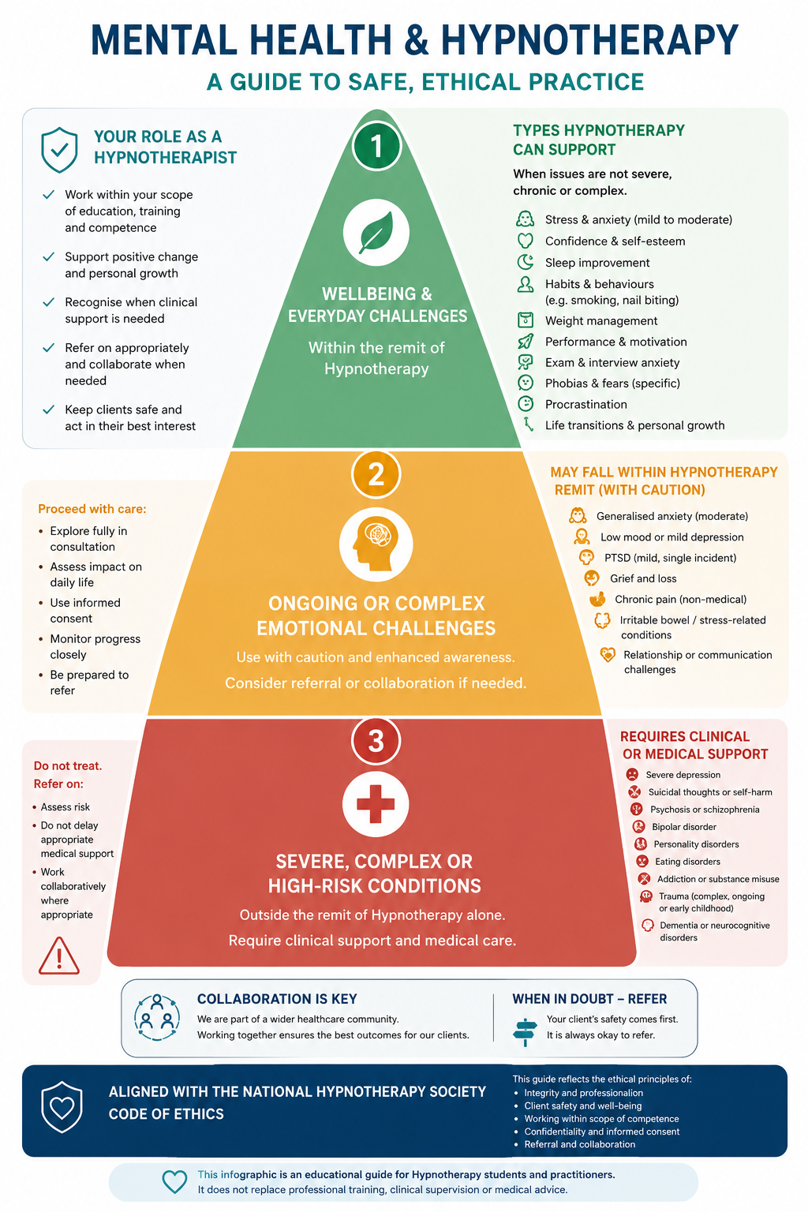

Slide 17
What Hypnotherapy Should NOT Treat Alone
High-risk or specialist presentations
  Psychosis or severe psychiatric instability
  Active suicidality and self harm
  Severe eating disorders without MDT involvement
  Complex trauma beyond competence
  Serious safeguarding concerns
  Undiagnosed medical conditions
  Any issue requiring medical diagnosis or crisis intervention

Slide 18
What Hypnotherapy CAN Help With
Areas with supportive evidence or clinical utility
  Anxiety reduction
  Relaxation and emotional regulation
  Sleep and habit difficulties
  Pain management and procedural anxiety
  IBS and functional gastrointestinal symptoms
  Confidence, resilience and coping skills
  Adjunctive support alongside CBT or medical care

Slide 19
Hypnosis & CBT
Complementary approaches
  Hypnosis can enhance relaxation and receptivity
  CBT provides structured cognitive and behavioural strategies
  Combined approaches may support anxiety and habit change
  Self-hypnosis can reinforce coping skills
  Behavioural rehearsal and imagery are highly compatible

Slide 20
Ethics & Boundaries
Protecting children and practitioners
  Work within competence
  Obtain supervision regularly
  Maintain transparent communication
  Avoid dependency and dual relationships
  Use evidence-informed approaches
  Document consent, risk and safeguarding actions

Slide 21
Suggested Session Structure
Example 45–50 minute model
  5 mins: Check-in and goals ‘what’s been better’
  10 mins: Collaborative discussion/play-based exploration
  10–15 mins: Hypnotic or imagery intervention
  10 mins: Skills rehearsal and future pacing
  5 mins: Parent feedback and home practice

Slide 22
Suggested Session Structure 2
Example 45–50 minute model
  10–15 mins: Hypnotic or imagery intervention for co-regulation
  5 mins: Check-in and goals ‘what’s been better’
  10 mins: Collaborative discussion/play-based exploration
  10 mins: Skills rehearsal and future pacing
  5 mins: Parent feedback and home practice

Slide 23
Key Takeaways
Successful CYP hypnotherapy requires
  Specialist knowledge beyond adult practice
  Flexibility, creativity and collaboration
  Strong safeguarding awareness
  Developmentally appropriate communication
  Ethical and culturally responsive care
  Clear referral pathways and supervision

Slide 24
References & Resources
Useful UK resources
  NHS England Child & Young People Mental Health resources
  British Society of Clinical Hypnosis (BSCH)
  CNHC professional standards
  NICE guidance for anxiety, depression and trauma
  YoungMinds and Anna Freud Centre resources
  Safeguarding training via NSPCC or local authorities

